Slide 1
Fostering an Equitable Tenure Culture: Administrator and Faculty Collaboration to Reduce Bias at Elgin Community College
Dr. Kristina C. Alcozer Garcia
Dean, Division of Communications and Behavioral Sciences
Dr. Tyler Roeger
Associate Dean, Center for the Enhancement of Teaching, Assessment, & Learning

Slide 2
Why Focus on Equitable Tenure Support Resources?
Experiences at ECC
Faculty sharing experience of the tenure process
Disparity in Representation and Retention:
Disparity in both the representation and retention of faculty with marginalized identities
About one-fifth of all graduate assistants, full-time faculty, and part-time faculty identified as people of color in fall 2017
Lack of representation of non-White faculty within tenure rank roles (more likely to be instructors, lecturers with no academic rank) (ACE, 2020).
Potential for Student Racial Bias in the Student Evaluation Process
Student evaluations of instructors are biased, noting that women are more likely to receive lower ratings compared to their male-identified counterparts (Boring, 2017; Chávez & Mitchell, 2020)
Faculty of Color who also receive lower ratings in studies designed to examine students’ perceptions of faculty and how they correlate to the faculty members’ racial identities (Chávez & Mitchell, 2020; Lazos, 2012).
*(ACE, 2020) American Council on Higher Education - Race and Ethnicity in Higher Education: 2020 Supplement

Slide 3
Why Focus on Equitable Tenure Support Resources?
Racialized Experience During the Tenure Process
Faculty of Color report experiencing increased challenges during the tenure process
Lack of understanding of their unique experiences of intersecting racial identities (Arnold, Crawford, Khalifa, 2016; Knight, 2010; Pittman 2012).
Consistent with Emerging Best Practices
Recommended the development of specialized trainings/workshops and support for instructional leadership involved in the tenure and promotion process,
Crucial for acknowledging and supporting the experiences of tenure track Faculty of Color (Benitez, James, Joshua, Perfetti, & Vick, 2017; Berry & Mizelle, 2006; Goodman, 2011; Knight, 2010; Lazos, 2012; Pittman, 2012).

Slide 4
The Opportunity to Change
Support the retention of Faculty with marginalized identities
Tangible support for tenure committee members to approach tenure process with an equity-focused mindset
Alignment with institutional planning:
ECC Strategic Plan
Illinois Equity in Attainment Initiative (ILEA) Plan

Slide 5
Purpose of this Project
Creation of Equitable Tenure Seminar Series designed to:
Explore the role of implicit bias in the experiences of faculty
Explore research related to student racial bias, intersectionality, microaggressions, and racial battle fatigue for faculty with marginalized identities.
Share extant research related to bias in student evaluations, complaints
Provide strategies for fostering a supportive tone for the entirety of the tenure process
Share methods for providing constructive feedback that is culturally responsive and developmentally appropriate

Slide 6
About ECC’s Tenure Process
*Present structure of ECC Tenure Process
Focused on instruction
Approximately 3 years in length
Process Includes:
Classroom observations (6 total)
Annual self assessment
Annual content portfolio submission
Annual Summary Conference
Tenure Committee Composition:
Dean/Designee (Chair)
Instructional Coordinator
1 Faculty Member (Dean’s Choice)
1 Faculty Member (Tenure Candidate’s Choice)

Slide 7
Our Approach
Student Success Infrastructure (SSI) Initiative
Faculty/staff/admin proposed equity-focused initiatives
Opportunity to pilot and potentially institutionalize
*Now shifted to new structure
Equitable Tenure Seminar Series Proposal
Proposed Spring 2021
Collaboration between faculty and administrators
Funds for the development and delivery of equitable tenure seminar series by third party

Slide 8
Our Approach
Proposal General Structure
Provided general multi-part seminar structure (synchronous virtual delivery)
Potential topics, general aim included in overview
Trust Building
Built-in opportunities for stakeholder feedback throughout development
Initial delivery and development by known third-party

Slide 9
Key Elements
Development process - 1 semester in length (Fall 2021)
Dr. Meagan Pollock of Engineer Inclusion
Formative Feedback - “Listening” Sessions
Faculty
Administrators
Facilitated by Dr. Meagan Pollock and Dr. Kristina Garcia
Provide space for stakeholders to provide feedback on:
Training content
Session structure and delivery
Voice concerns and discuss “wishlist” items
Pre-and Post-Survey

Slide 10
Our Timeline
Confirm seminar development Package with instructor (depending on funding approval and Institutional leadership) – July 2021
Confirm faculty advisor group – August 2021
10 members, representing various disciplines (includes Library Faculty)
Confirm admin advisor group - August 2021
Comprised of academic deans and associate deans
First Round of Feedback - “Listening” Sessions - October 2021
Develop seminar modules (with advisory group feedback) and assessment plan – November 2021
Host first round of optional seminars Spring – Spring 2022
Host second round of optional seminars Spring - Spring 2023

Slide 11
Series Structure
Part 1: Practices for Reducing the Influence of Bias on the Tenure Review Process
Naming and Recognizing Form of Bias
Part 2: Guidelines for Shifting from Gatekeeping to Stewardship in the Tenure Review
Defining and Identifying Practices and Policies that Prioritize Gatekeeping Stewardship Rather than Gatekeeping
Part 3: Skills for Supporting Faculty Through the Tenure Review Process
Strategies for Providing Feedback
Notes:
TYLER

Slide 12
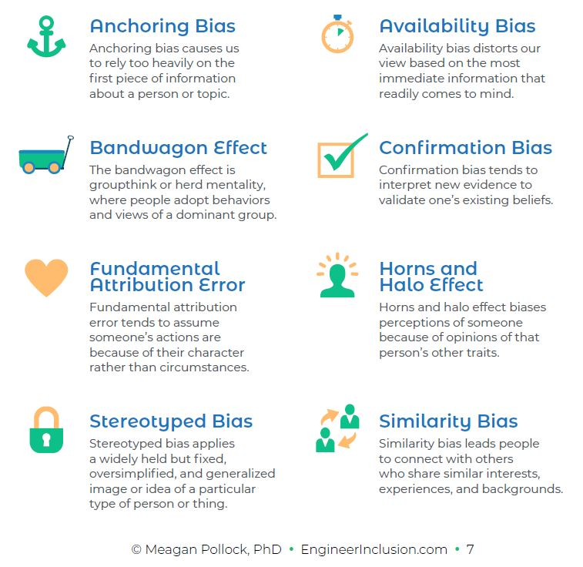
Providing a Name

Slide 13
Series Structure
Part 1: Practices for Reducing the Influence of Bias on the Tenure Review Process
Naming and Recognizing Form of Bias
Part 2: Guidelines for Shifting from Gatekeeping to Stewardship in the Tenure Review
Defining and Identifying Practices and Policies that Prioritize Gatekeeping Stewardship Rather than Gatekeeping
Part 3: Skills for Supporting Faculty Through the Tenure Review Process
Strategies for Providing Feedback
Notes:
TYLER

Slide 14
Special Attention To
Frameworks to provide language
Case study examples
Reflection on positionality
Notes:
TYLER

Slide 15
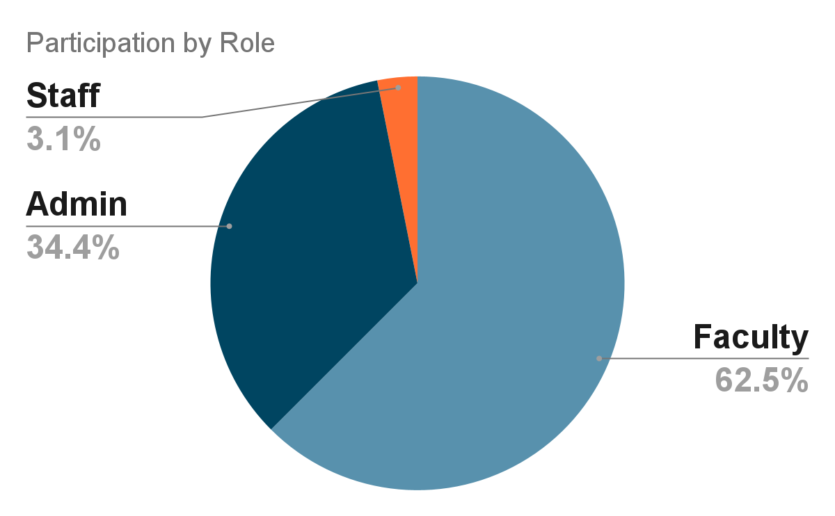
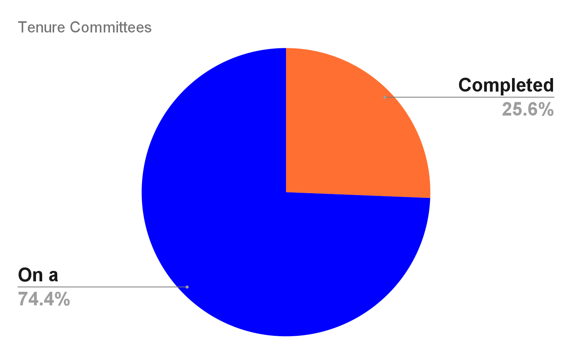
Participation
Notes:
TYLER

Slide 16
Pre-Survey: Strongest Agreement
1. I believe that it is important that I continually work to improve my multicultural competence to better understand faculty.
1. I believe that systemic inequalities impact marginalized populations in ways that I cannot always see.
2. I believe that it is my responsibility to reduce interpersonal bias that affects my interactions and evaluations of others.
Notes:
TYLER

Slide 17
Pre-Survey: Least Agreement
1. I feel confident in my ability to reduce institutional bias in the promotion and tenure of marginalized faculty.
2. I feel confident in my ability to monitor and improve the culture and climate of the promotion and tenure process for marginalized people.
Notes:
TYLER

Slide 18
Post-Survey: Most Agreement
1. I believe that it is important that I continually work to improve my multicultural competence to better understand faculty.
1. I believe that systemic inequalities impact marginalized populations in ways that I cannot always see.
2. I believe that it is my responsibility to reduce interpersonal bias that affects my interactions and evaluations of others.

Slide 19
Post-Survey: Least Agreement
1. I feel confident in my ability to monitor and improve the culture and climate of the promotion and tenure process for marginalized people.
2. I reflect on my positionality before making assumptions about faculty.
2. I am knowledgeable of how my positionality affects my understanding of and outlook on the world.
Notes:
TYLER

Slide 20
Additional Impacts
“The frameworks and vocabulary provided great resources to use for tenure and other meetings.”
“I particularly appreciated the discussion of various scenarios and the sharing of tangible tools/resources that I can integrate into my practices.”
Notes:
TYLER

Slide 21
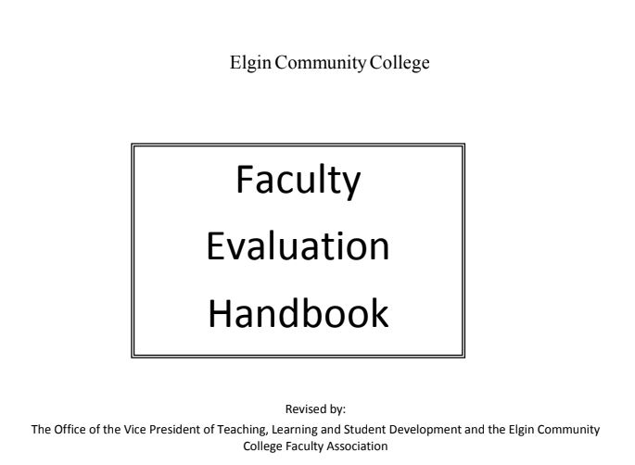
Next Steps
Institutionalizing in Evaluation Processes
Recommendations for requirement for serving on a tenure committee
Providing tangible resources
Tenure Committee Resource Guide
Notes:
TYLER

Slide 22
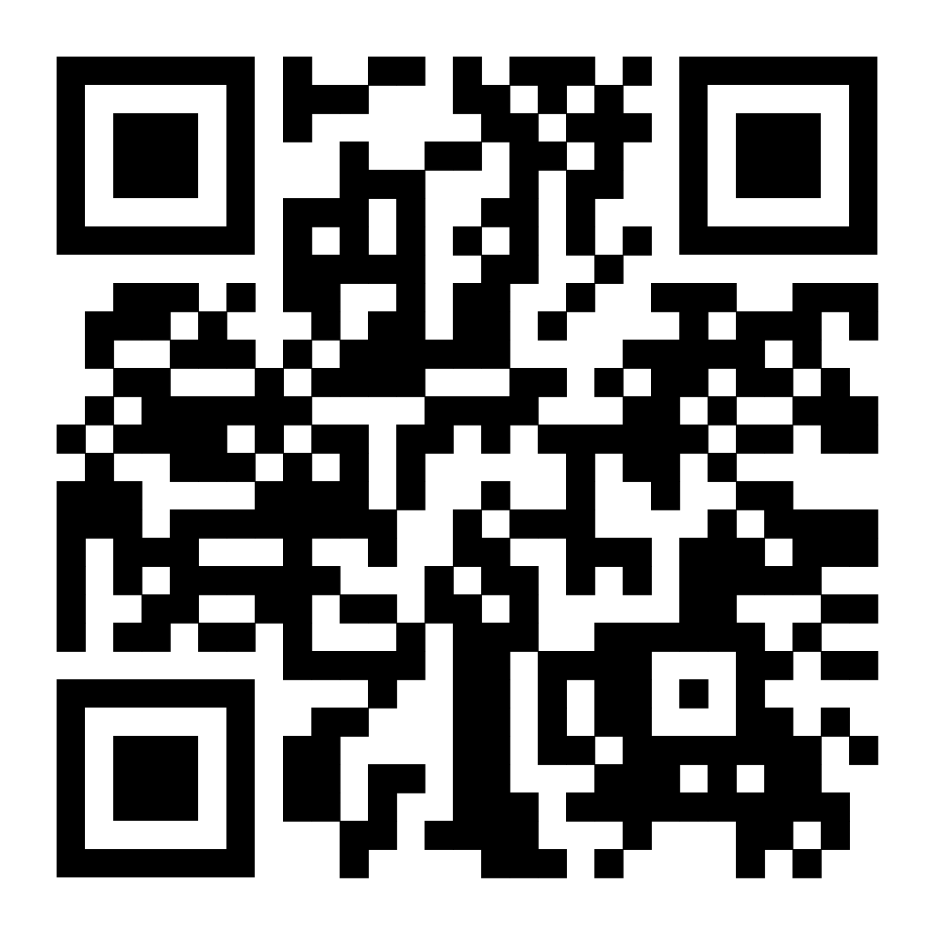
Staying Connected
Dr. Kristina C. Alcozer Garcia
Dean, Division of Communications and Behavioral Sciences
kgarcia@elgin.edu
Dr. Tyler Roeger
Associate Dean, Center for the Enhancement of Teaching, Assessment, & Learning
troeger@elgin.edu
Sharing Engineer Inclusion Consultant Contact
Dr. Meagan Pollock Chief Inclusion Engineer Engineer Inclusion mp@engineerinclusion.com

